Slide 1
Math 769: Statistical Learning

Slide 2
Linear Discriminant Analysis (LDA)
Shahrzad Jamshidi, PhD

Slide 3
Last Lesson
We discussed two distinct approaches to classification with linear regression: ordinal and one-hot encoding
We also discussed the three metrics one can used when evaluating a classification model: accuracy, precision, and recall.

Slide 4
Objectives
State the problem of classification from the perspective of Statistical Decision Theory.
Define LDA and the estimates it performs based on the statistical framing of the classification problem.
State the LDA rule.

Slide 5
Linear Discriminant Analysis (LDA)
LDA is a supervised classification technique that aims to maximize the distance between classes while minimizing the variance within them via projection.
Two-class approach first developed by Ronald A. Fisher in the 1930s.
Multiple class approach was developed by C.R. Rao.

Slide 6
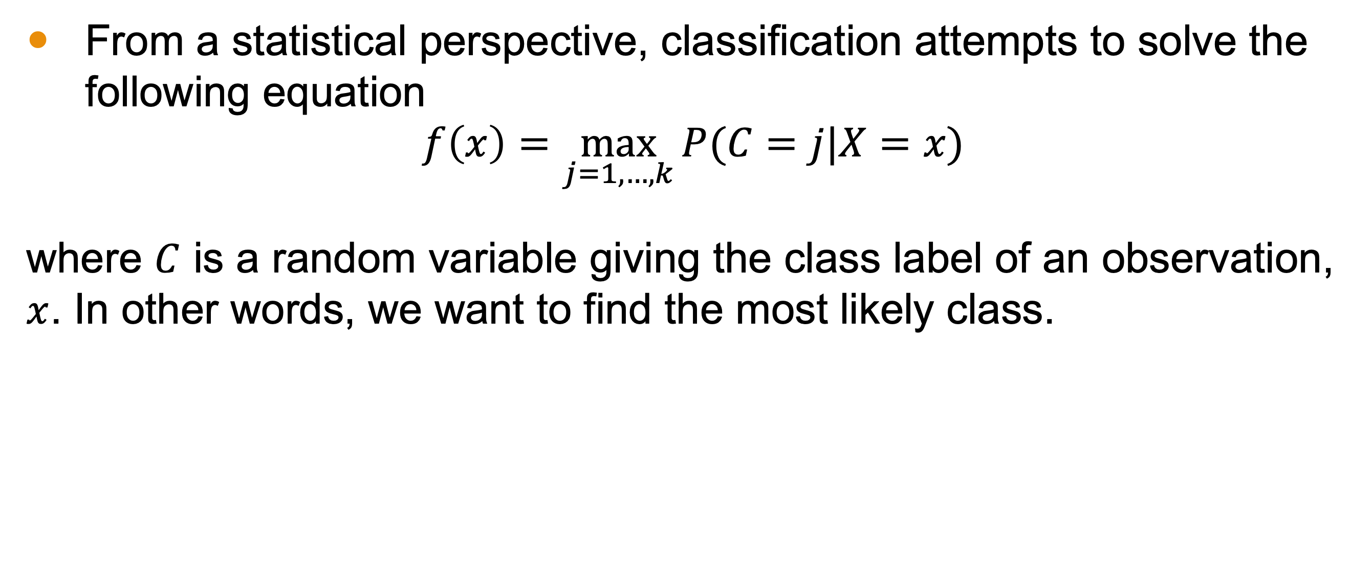
Statistical Decision Theory
From a statistical perspective, classification attempts to solve the following equation
$$f\left(x\right)=\max_{j=1, …, k}{P(C=j|X=x)}$$
where $C$ is a random variable giving the class label of an observation, $x$. In other words, we want to find the most likely class.

Slide 7
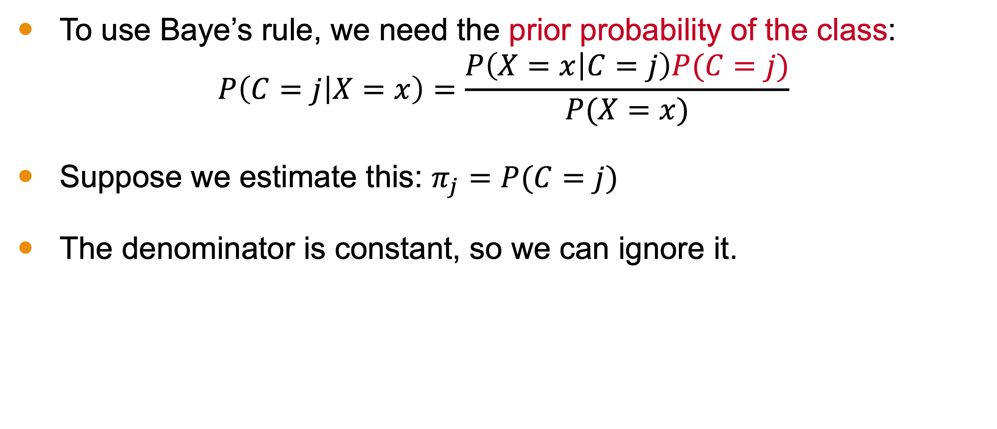
Statistical Decision Theory
To use Baye’s rule, we need the prior probability of the class:
$$P\left(C=j | X=x\right)=\frac{P\left(X=x | C=j\right)P(C=j)}{P(X=x)}$$
Suppose we estimate this: $π_{j}=P(C=j)$
The denominator is constant, so we can ignore it.

Slide 8
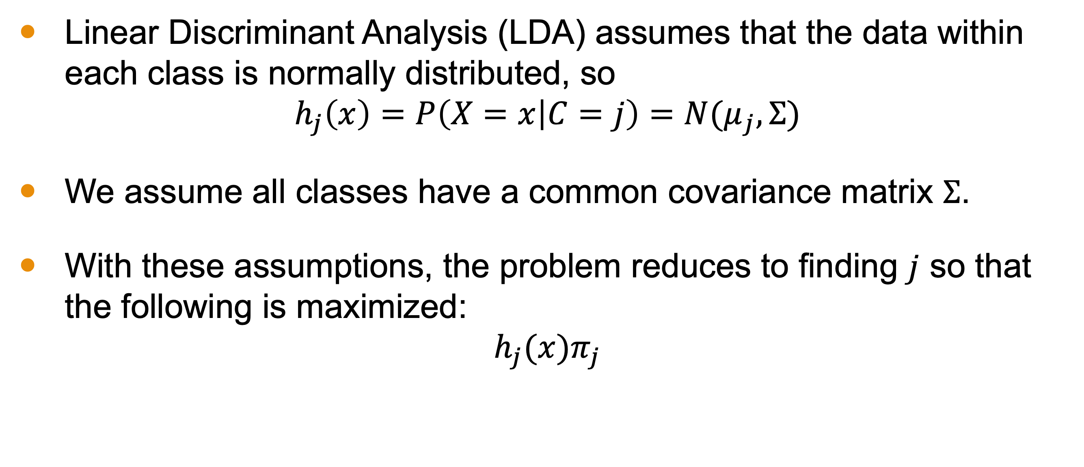
Linear Discriminant Analysis (LDA)
Linear Discriminant Analysis (LDA) assumes that the data within each class is normally distributed, so
$$h_{j}\left(x\right)=P\left(X=x | C=j\right)=N(μ_{j},Σ)$$
We assume all classes have a common covariance matrix $Σ$.
With these assumptions, the problem reduces to finding $j$ so that the following is maximized:
$$h_{j}(x)π_{j}$$

Slide 9
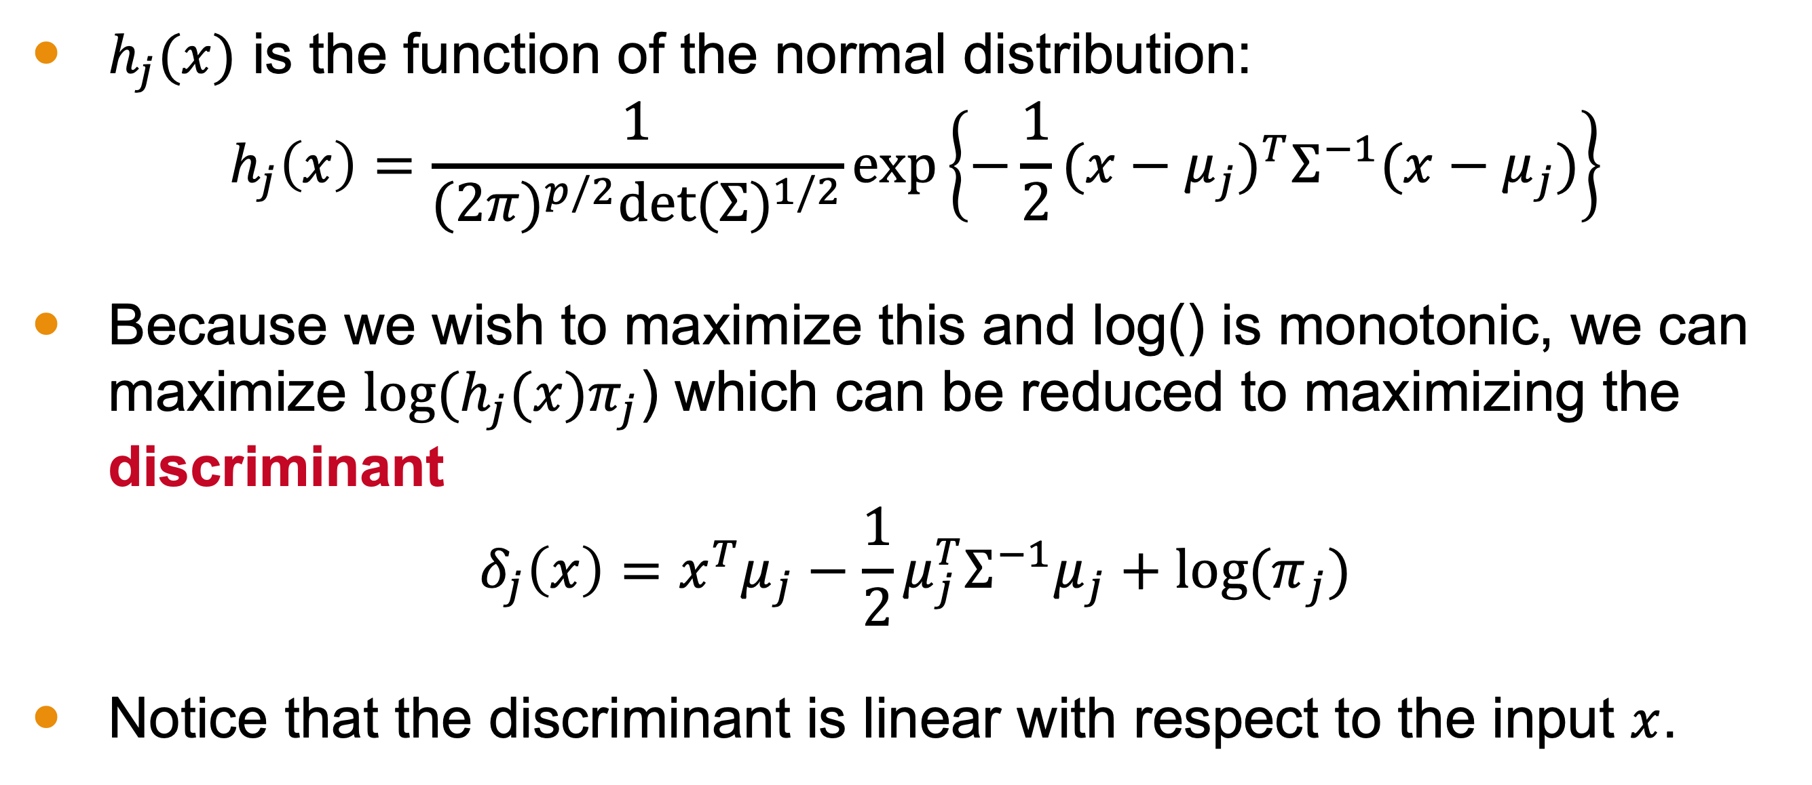

Maximizing $h_{j}(x)π_{j}$
$h_{j}(x)$ is the function of the normal distribution:
$$h_{j}\left(x\right)=\frac{1}{{(2π)}^{p/2}{\text{det}(Σ)}^{1/2}}\text{exp}\left\{−\frac{1}{2}{(x−μ_{j})}^{T}Σ^{−1}(x−μ_{j})\right\}$$
Because we wish to maximize this and log() is monotonic, we can maximize $log⁡(h_{j}(x)π_{j}$) which can be reduced to maximizing the discriminant
$$δ_{j}\left(x\right)=x^{T}μ_{j}−\frac{1}{2}μ_{j}^{T}Σ^{−1}μ_{j}+\text{log}{(π}_{j})$$
Notice that the discriminant is linear with respect to the input $x$.

Slide 10
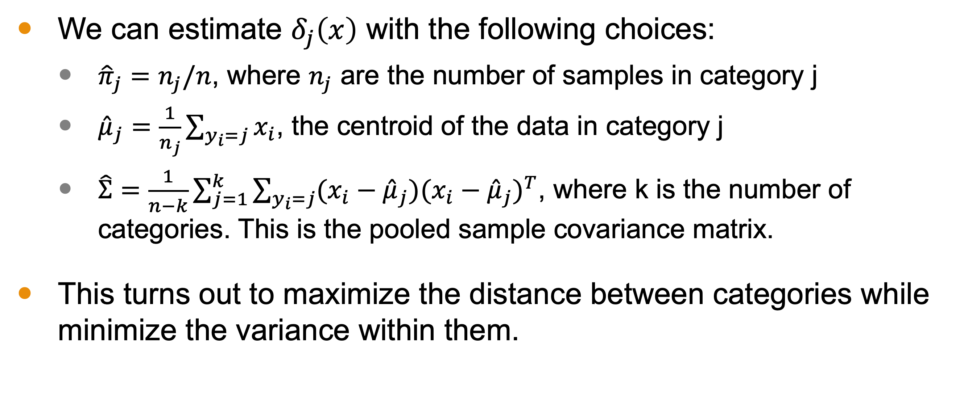
Estimates for Maximization
We can estimate $δ_{j}\left(x\right)$ with the following choices:
${\hat{π}}_{j}=n_{j}/n$, where $n_{j}$ are the number of samples in category j
${\hat{μ}}_{j}=\frac{1}{n_{j}}\sum_{y_{i}=j}{x_{i}}$, the centroid of the data in category j
$\hat{Σ}=\frac{1}{n−k}\sum_{j=1}^{k}{\sum_{y_{i}=j}{(x_{i}−{\hat{μ}}_{j}){(x_{i}−{\hat{μ}}_{j})}^{T}}}$, where k is the number of categories. This is the pooled sample covariance matrix.
This turns out to maximize the distance between categories while minimize the variance within them.

Slide 11
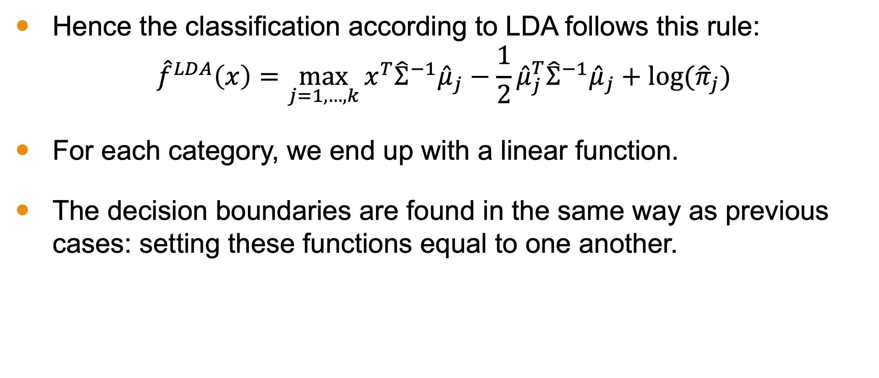
LDA Rule
Hence the classification according to LDA follows this rule:
$${\hat{f}}^{LDA}\left(x\right)=\max_{j=1,…,k}{x^{T}{\hat{Σ}}^{−1}{\hat{μ}}_{j}−\frac{1}{2}{\hat{μ}}_{j}^{T}{\hat{Σ}}^{−1}{\hat{μ}}_{j}+\text{log}\text{(}{\hat{π}}_{j}\text{)}}$$
For each category, we end up with a linear function.
The decision boundaries are found in the same way as previous cases: setting these functions equal to one another.

Slide 12
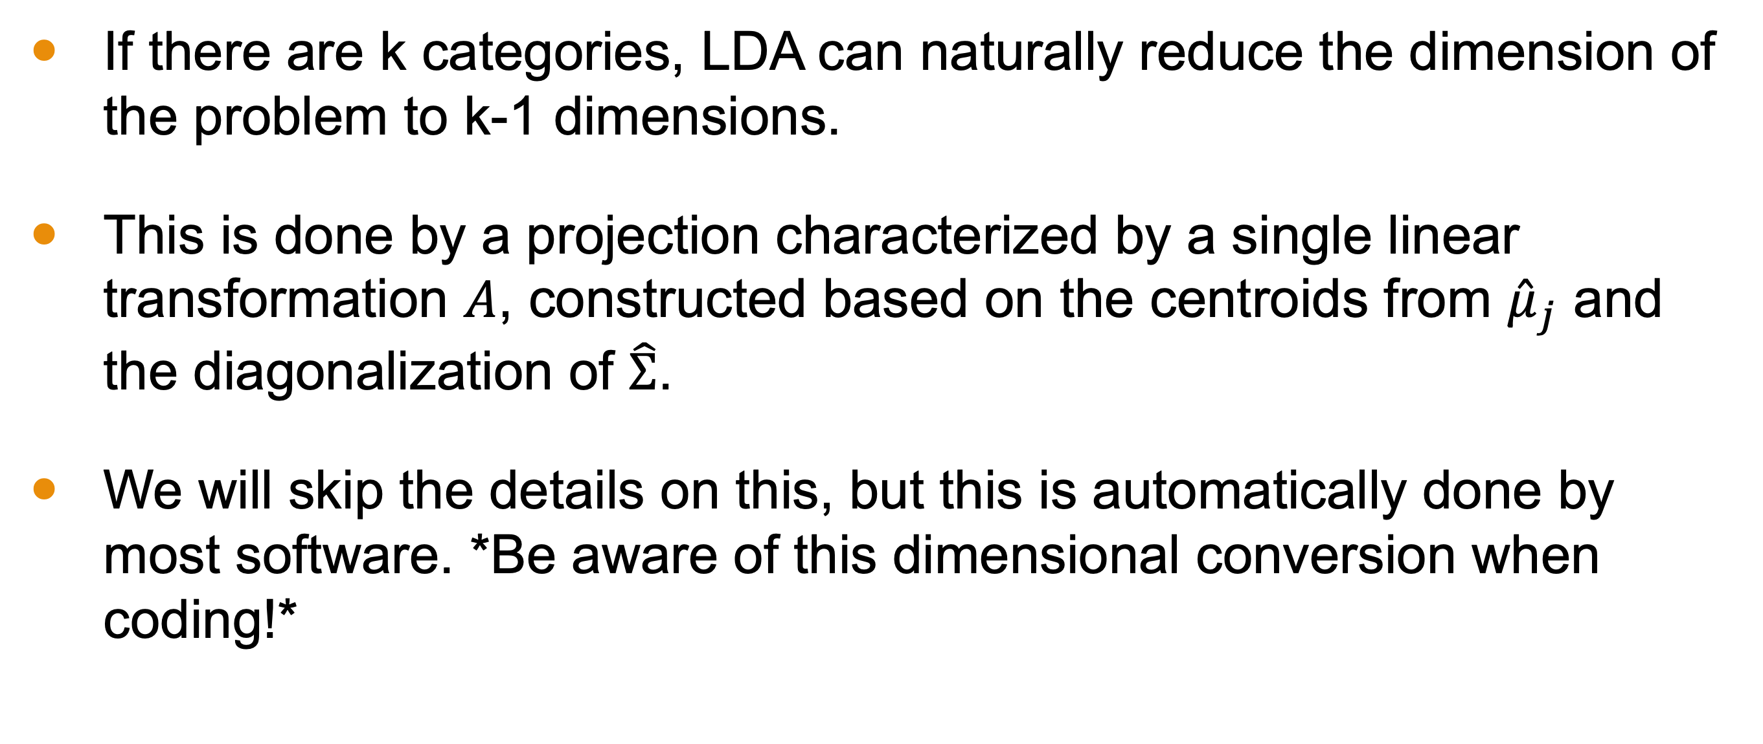
Reduced-Rank LDA
If there are k categories, LDA can naturally reduce the dimension of the problem to k-1 dimensions.
This is done by a projection characterized by a single linear transformation $A$, constructed based on the centroids from ${\hat{μ}}_{j}$ and the diagonalization of $\hat{Σ}$.
We will skip the details on this, but this is automatically done by most software. *Be aware of this dimensional conversion when coding!*

Slide 13
Conclusion
Linear Discriminant Analysis (LDA) is a method of classification that attempts to look at the underlying statistical problem and maximize the distance between groups while minimizing the variance within them.
This clustering method can project the answer into a lower-dimensional space (k-1, where k is the number of categories).
One should be mindful of this projection when coding.

